Slide 1

15.05.2025
UCY AI Assistant
A RAG Chatbot Project
Authored & Developed by:
Retrieval Augmented Generation
Marios Menelaou, Mikhail Sumskoi, Maria Tsilidou, Chrysis Andreou, Constantinos Leonidou

Slide 2


1) Introduction
2) Foundational RAG Implementation
3) High-Level Frameworks – LangChain/LangGraph
4) High-Level Frameworks – OpenAI Agents
5) Discussion
6)Showcase
Presentation Structure

Slide 3
1) Introduction

Slide 4

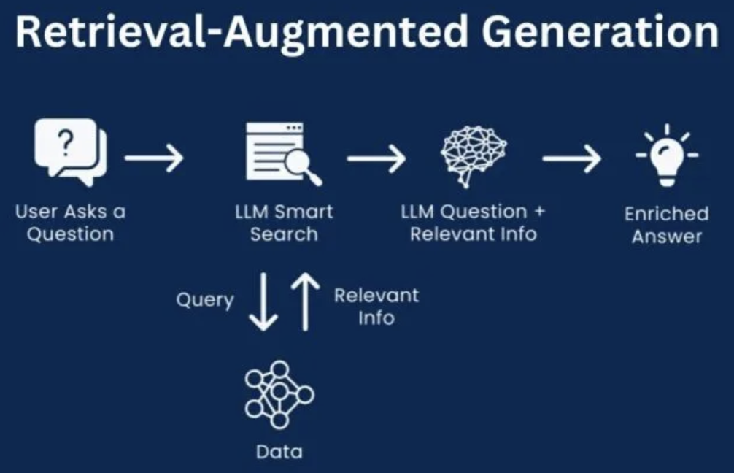
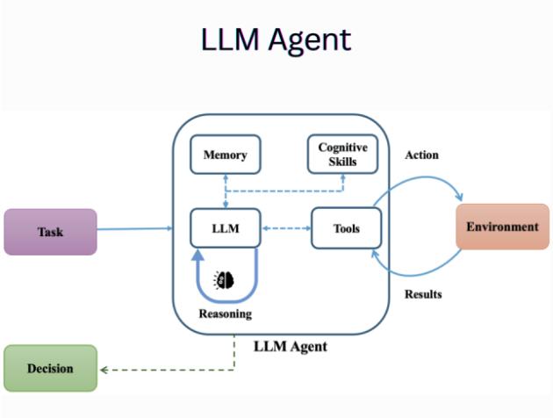
UCY AI ASSISTANT
04
RAG / AGENTS - A BRIEF EXPLANATION
Retrieval Augmented Generation - Retrieval-Augmented Generation (RAG) is an approach in natural language processing that combines retrieval and generation to improve the quality and accuracy of generated responses. Instead of relying only on the knowledge stored in a language model, RAG retrieves relevant information from an external knowledge source (like documents, a database, or a vector store) and then uses that information to generate a response.
Agentic Systems – Agentic systems are AI-driven frameworks designed to operate autonomously or semi-autonomously in pursuit of specific goals. These systems can make decisions, take actions, and adapt based on their environment, inputs, and internal reasoning processes. Unlike simple reactive tools, agentic systems often incorporate planning, memory, and feedback mechanisms to handle complex tasks over time and across multiple steps. They can interact with users, APIs, or other systems to complete objectives with minimal human intervention.

Slide 5
UCY AI ASSISTANT
05
Project Overview & Approach
Problem:
Addressing the challenge of accessing comprehensive and often complex university-related information at UCY.
Objective:
To explore and implement Retrieval Augmented Generation (RAG) technology to enhance information accessibility at UCY.
Methodology Snapshot - Three Core Approaches Investigated:
Foundational RAG Implementation (DeepDive into Core Mechanics)
Langchain/LangGraph Framework (High-Level Production-Grade Library)
OpenAI Agents SDK Framework (Alternative High-Level Orchestration)

Slide 6
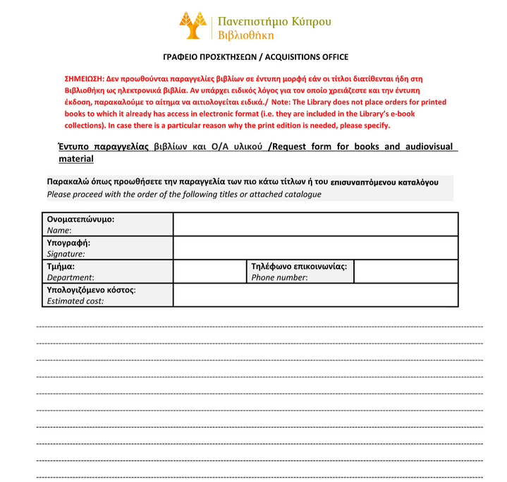
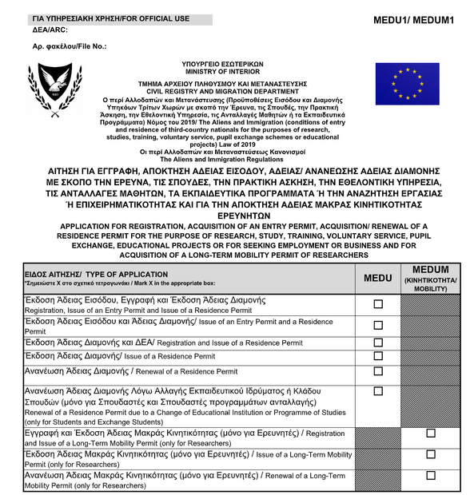
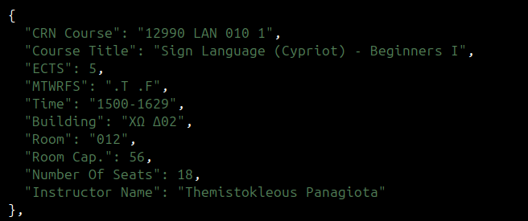
DATA PROPERTIES (EDA)
06
IMPLEMENTATION DETAILS
Mostly unstructured URL extracts of around 5647 units, each of length 1700 characters.
Chunked PDF-files, 3984 counts, each of around 2500 characters.
Fillout forms, 55, both in Greek and English. Each form has to be described.
Schedule files in the shape of JSON-objects.

Slide 7
2) Foundational RAG Implementation

Slide 8
UCY AI ASSISTANT
08
Foundational RAG Implementation
Topic: Foundational RAG: Understanding Core Mechanics
Purpose:
Gain deep, fundamental understanding of RAG pipeline components and their mechanics.
Key Focus:
Building a RAG system from scratch to explore core principles and demystify RAG operations.
Significance:
Essential team learning; established core principles before exploring high-level frameworks.

Slide 9
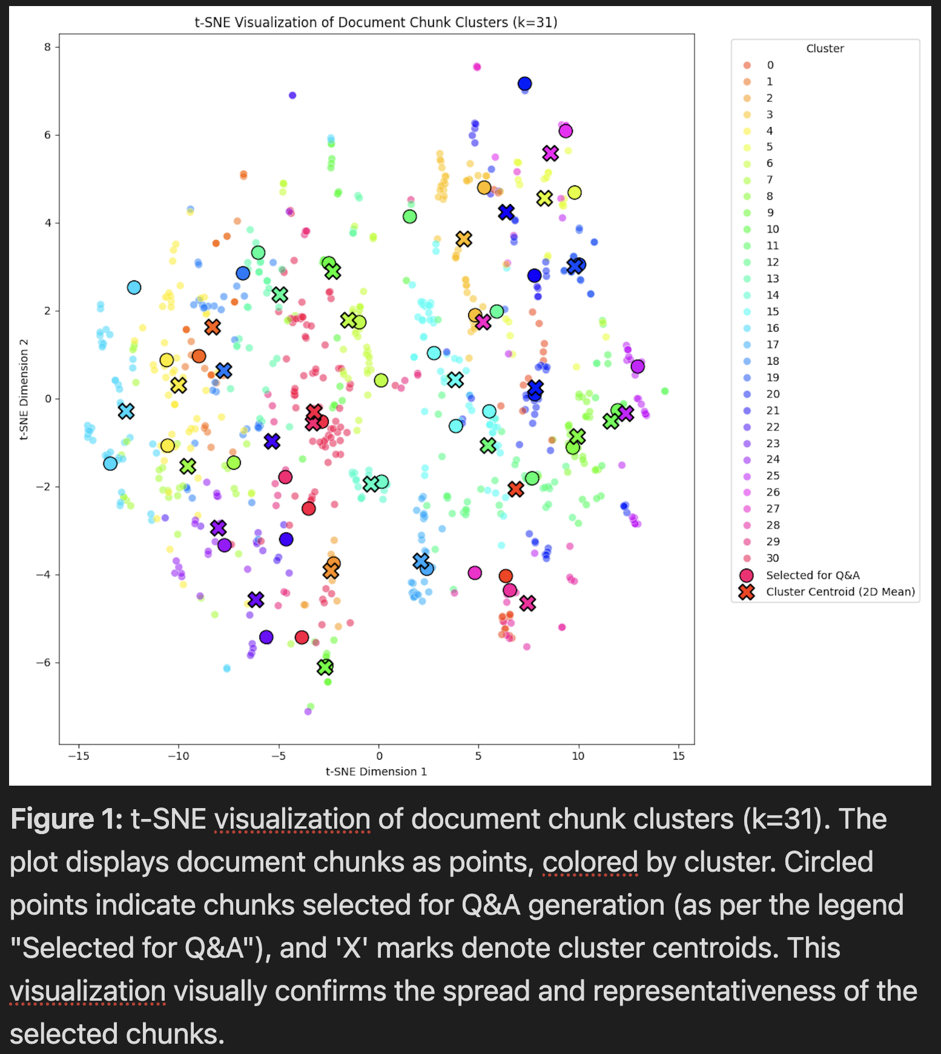
UCY AI ASSISTANT
09
Foundational RAG: Core Components & Process
Data Preprocessing Pipeline (UCY Web Data):
Acquisition: Fetching HTML content from UCY URLs.
Cleaning: HTML to Markdown conversion, keep main text.
Core RAG Architecture (Built from Scratch):
Chunking: SentenceSplitter for concise, semantically coherent chunks (200 char size, 20 overlap).
Embedding Model: intfloat/multilingual-e5-large-instruct for strong semantic retrieval for both Greek and English.
Vector Indexing: FAISS IndexFlatIP for efficient similarity search of chunk embeddings.
Retrieval: Top-5 similar chunks retrieved for user query.
Answer Generation: meta-llama/Llama-3.3-70B synthesizes answers from retrieved context.
Synthetic Question-Answer (QA) Dataset Generation:
Methodology: K-means clustering on document chunk embeddings for representative topic coverage.
Process: LLM (Llama-3.3-70B) generated QA pairs based solely on selected UCY content chunks.

Slide 10
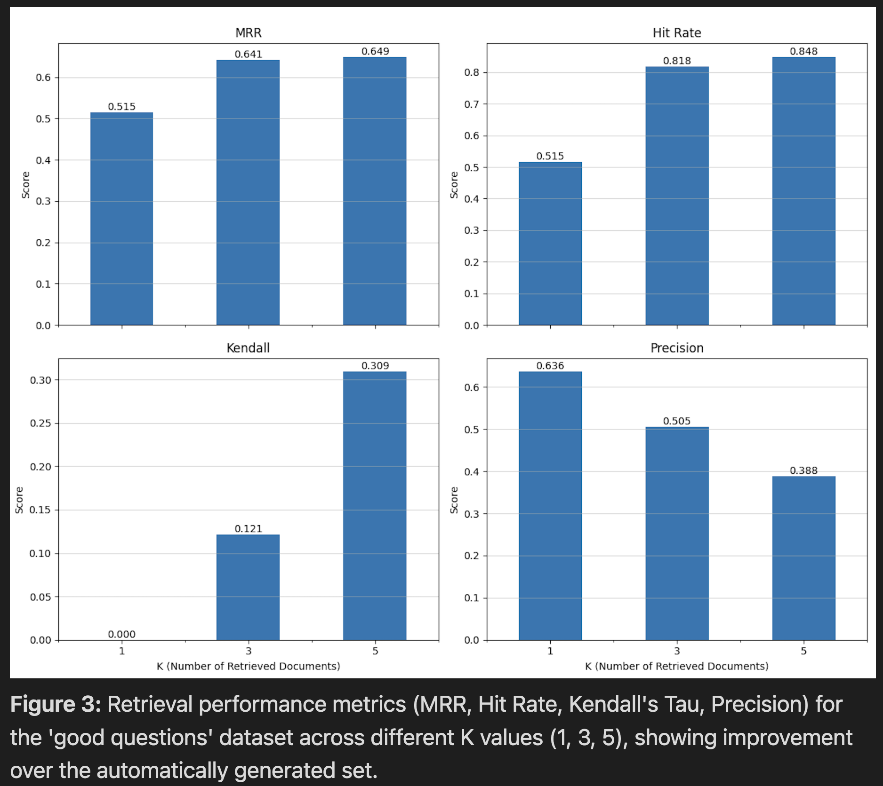
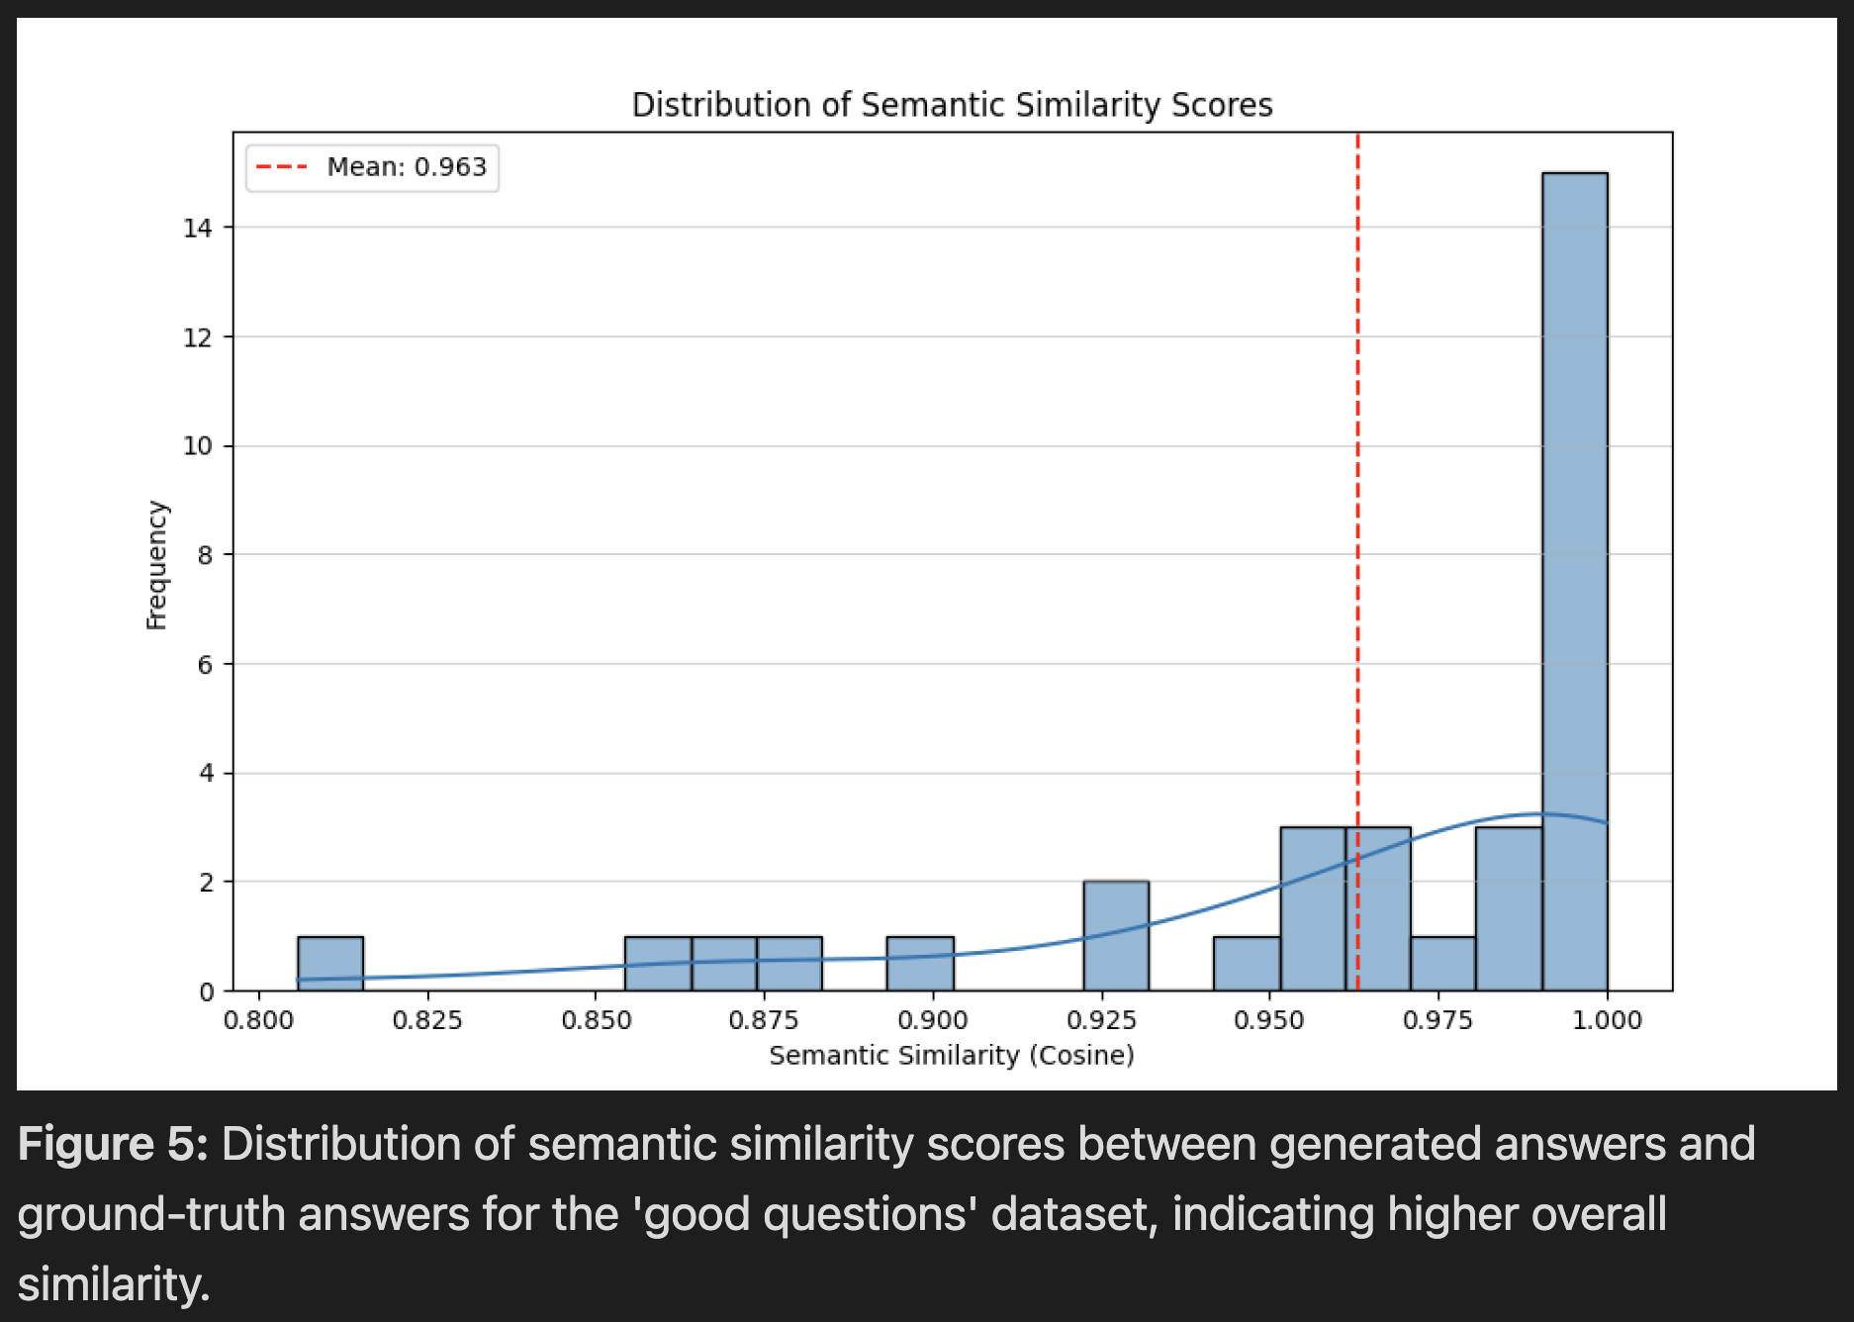
UCY AI ASSISTANT
10
Foundational RAG: Key Innovations & Evaluation Insights
Evaluation Methodology & Key Results:
Metrics: Assessed retrieval (Hit Rate@K, Mean Reciprocal Rank (MRR)@K) and generation (Mean Semantic Similarity).
Impact of Question Quality: "Good Questions" (manually curated) vs. all AI-generated questions:
Retrieval: Mean Hit Rate @5 Improved from 0.7381 to 0.8485.
Generation: Mean Semantic Similarity improved from 0.9429 to 0.9631.
Key Learning:
The quality and specificity of user questions critically impact both retrieval accuracy and the quality of generated answers.

Slide 11
3) High-Level Frameworks – LangChain/LangGraph

Slide 12
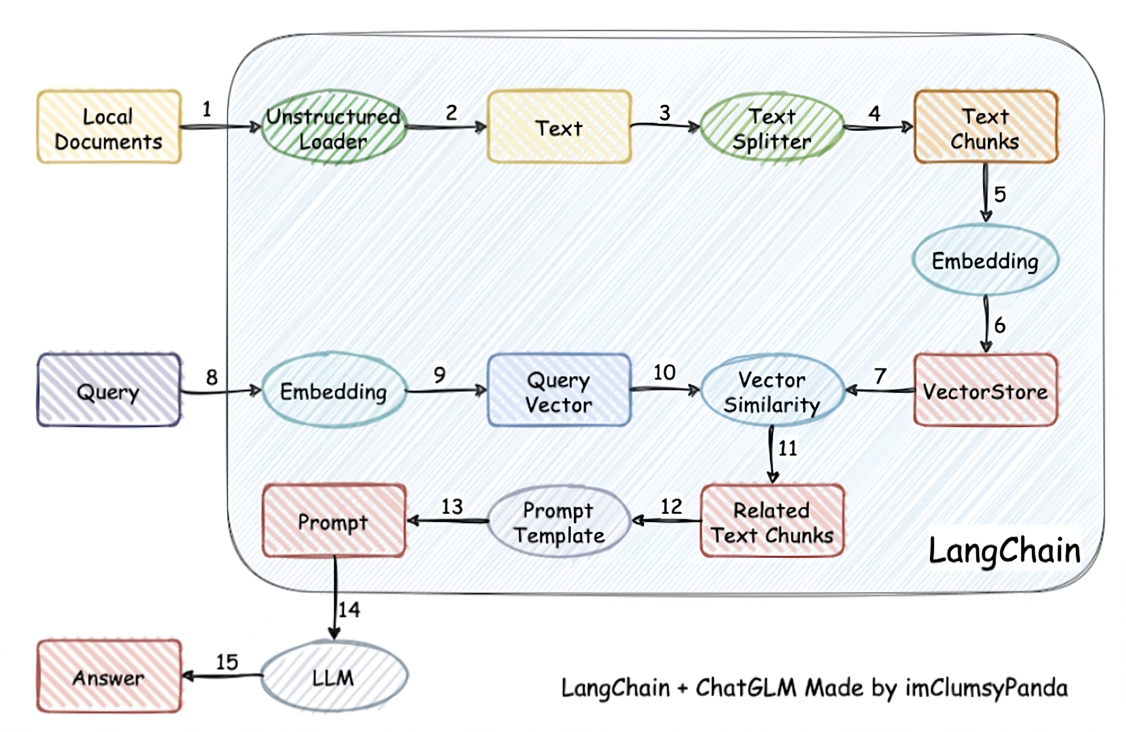



UCY AI ASSISTANT
12
IMPLEMENTATION DETAILS
COURTESY OF LANGCHAIN

Slide 13
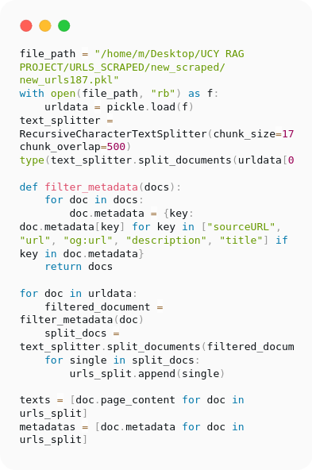
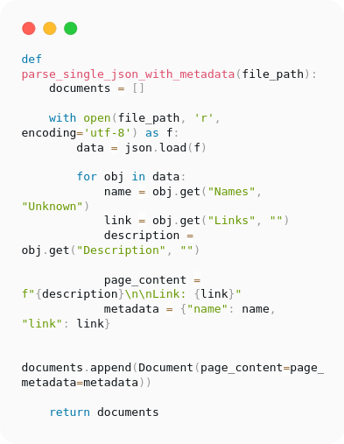
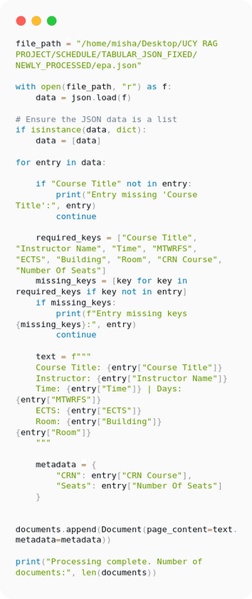
UCY AI ASSISTANT
13
IMPLEMENTATION DETAILS
JSON parsing
Schedule Data
Data Preprocessing for URLs

Slide 14
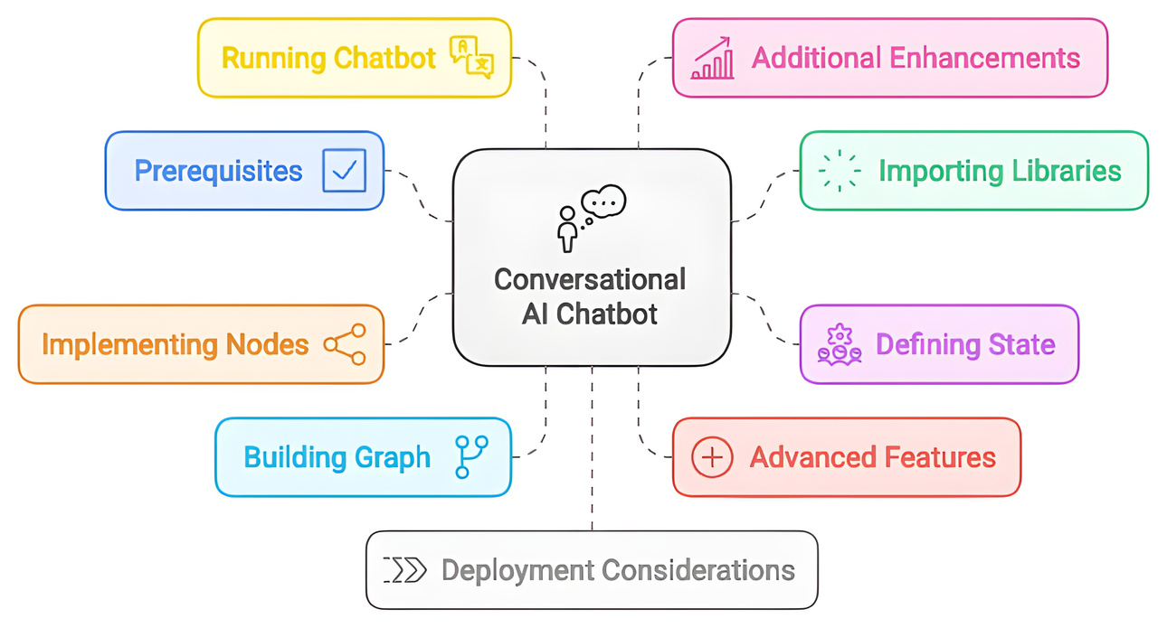
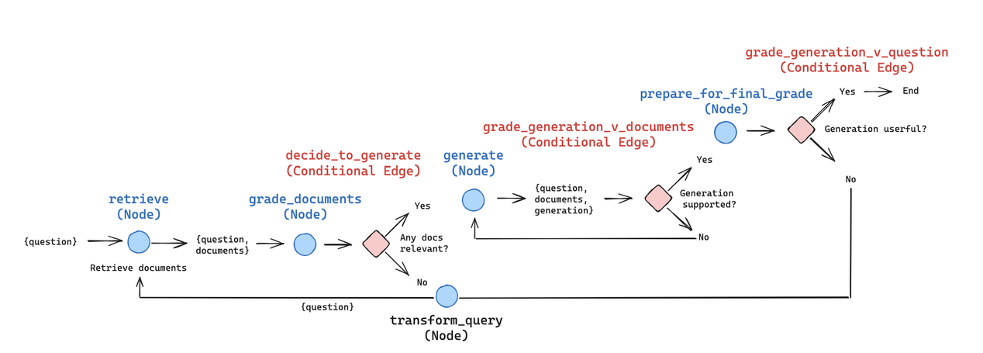
UCY AI ASSISTANT
14
IMPLEMENTATION DETAILS
The LangGraph framework allows to implement AI Agents that use nodes as their tools. The agent can make a decision to invoke a certain tool to get relevant information and provide a response informed by real-world data.
Nodes that we have implemented are:
General Question Node - answers general user questions regarding university courses, fees, programme contents, etc. Schedule Question Node - allows to fetch room numbers, instructor names, buildings, time of lessons.
Form Node - fetches URLs for forms to fill out.

Slide 15
UCY AI ASSISTANT
15
IMPLEMENTATION DETAILS - GENERAL QUESTION NODE
The General Question Node is informed by web-scraped URLs and university documentation, e.g. PDF files, course brochures, guides and other files that are freely accessible and represent public knowledge regarding the university.
This node is the backbone of the chatbot, since it contains the most information about courses, work processes and other aspects.
The node draws information from a PineCone index that contains embeddings for the aforementioned files.
Links to URLs have been embedded as metadata, which means that the user can always be routed to a website and examine it personally if needs be.

Slide 16
UCY AI ASSISTANT
16
IMPLEMENTATION DETAILS - SCHEDULE NODE
The Schedule Node is informed by schedule PDF files that list all the subjects in a certain department.
It allows to fetch precise information about lessons, rooms, professors and ECTS points.
This node is invoked when a user query concerns specific lessons / schedule questions.
The Form Node retrieves links to forms that have been abundantly described and embedded. This allows users to get the desired form.
This node also contains JSON objects that were embedded and upserted into PineCone.
For more efficient similarity search, each form contains some descriptions.

Slide 17

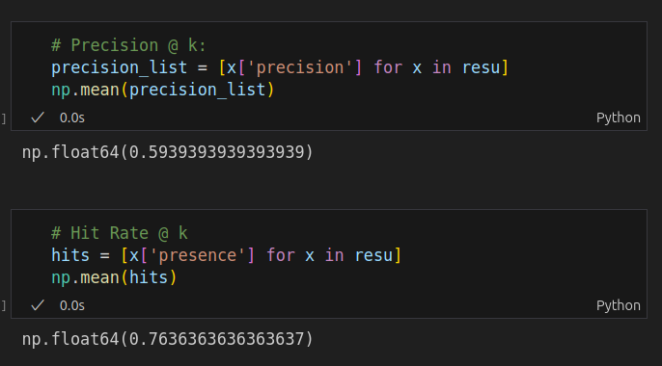
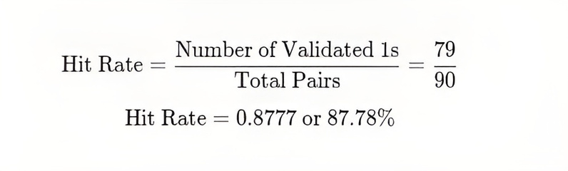
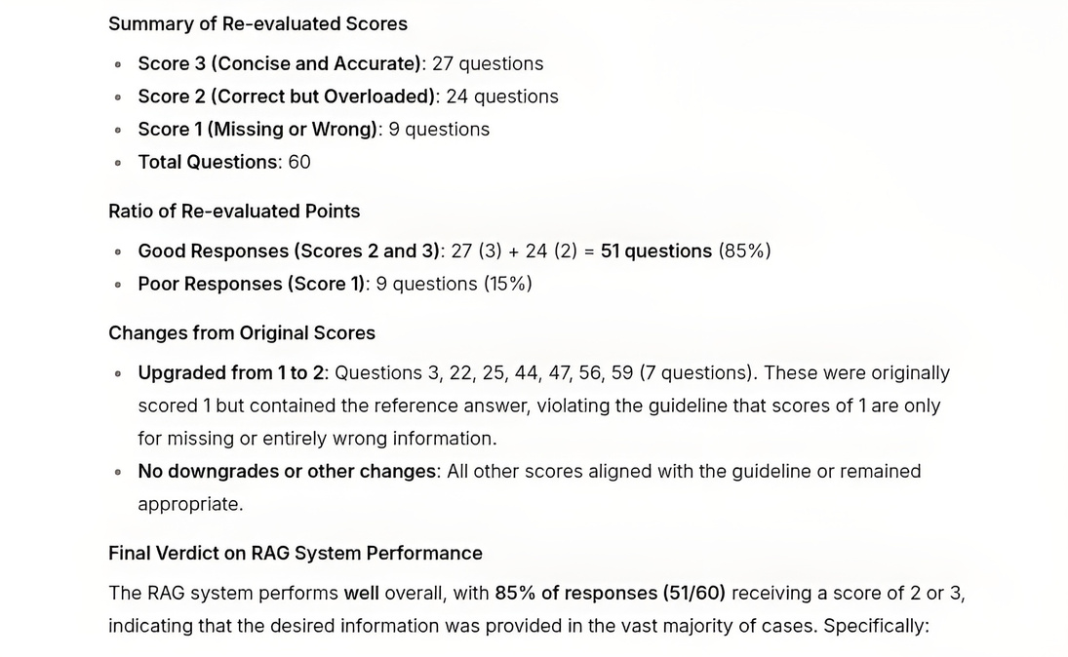
UCY AI ASSISTANT
17
IMPLEMENTATION DETAILS / EVALUATION
Chunking strategy - create large chunks with strong overlap using LangChain’s RecursiveCharacterSplitter
Embeddings - create embeddings using a state-of-the-art embedding model
Document Vectorization Strategy - instead of relying on SQL-search agents, we have decided to create embeddings for all the data - including web-scraped URLs (the university website), JSONs (schedules) and generic PDF / docx files. Our decision is primarily based on the fact that there is a high chance of misspellings, as well as bilingual requests written in both English and Greek.
Evaluation Strategy - since the majority of metrics may not be representative of the real RAG results, we used both llm-as-a-judge and Hit Rate @ k + Precision @ k metrics.

Slide 18
4) High-Level Frameworks – OpenAI Agents

Slide 19
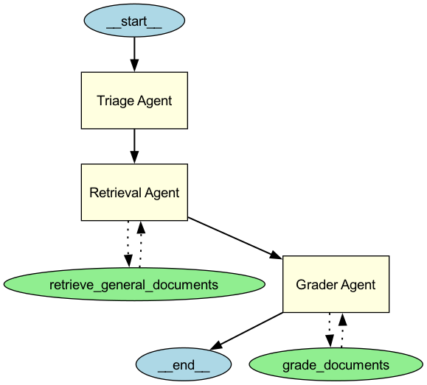
UCY AI ASSISTANT
19
IMPLEMENTATION DETAILS – HIGH LEVEL Framework – OpenAI Agents
OpenAI Agents Framework for high-level orchestration
Declarative and modular structure.
Simplifies sub-agent coordination and task planning.
Integrates tools (e.g., retrieval, grading) seamlessly.
Context Management (memory management – stateful).
Orchestration
Why use a high-level framework such as OpenAI Agents SDK?
Reusability – Components can be used for different use cases.
Reliability – the agent performs consistently and correctly under various conditions due to structured workflows and tool integration.
Maintainability – the system can be easily updated, extended, or debugged thanks to its modular and well-organized architecture.

Slide 20
UCY AI ASSISTANT
20
IMPLEMENTATION DETAILS – HIGH LEVEL Framework – OpenAI Agents
Orchestration and Short-Term Memory
Triage Agent (Master Agent):
Central controller ensuring correct execution order.
Coordinates sub-agents and maintains workflow logic.
Enables Human-in-the-Loop: requests user input when needed allowing sub-agents to return to Triage Agent.
Orchestration
Short-Term Memory (Rag Agent Context):
Preserves
Enables
Question
Retrieved chunks
Intermediate outputs
Coherent multi-turn interactions
Shared state between sub-agents
Up-to-date data

Slide 21
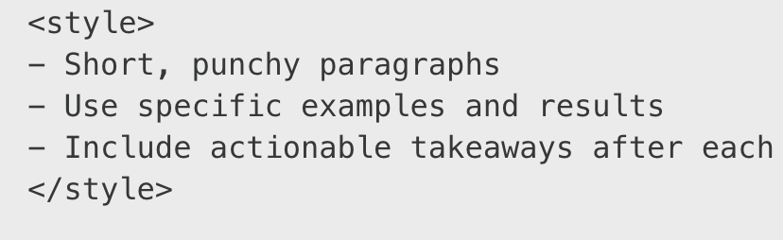
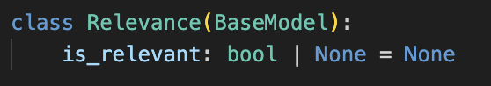
UCY AI ASSISTANT
21
IMPLEMENTATION DETAILS – HIGH LEVEL Framework – OpenAI Agents
Key Techniques in this Implementation
XML Tags & Prompt Engineering
Orchestration
XML Tags are shown to boost instruction-following accuracy for LLMs since models have seen a lot of XML data in their training datasets. (MacCallum & Lee, 2025).
Role following and structured output parsing are prompt engineering techniques that were also used for guiding the agent’s behaviour.
Document relevance grading using LLM as a tool
Assesses each chunk’s relevance to the query.
Filters irrelevant content to reduce hallucinations and increase precision.
Pydantic schema, guided output

Slide 22
5) Discussion

Slide 23




UCY AI ASSISTANT
23
POTENTIAL BENEFITS
More customers - due to the fact that the system makes information about specific courses, their conditions and fees more accessible.
Better User Experience - the integration into the university will be more seamless with a single and accessible consultation agent.
Decreased Workload - the bulk of user questions will be handled by the bot; only specific questions will be handled by university workers.

Slide 24
UCY AI ASSISTANT
24
Overall Discussion: Key Learnings, Comparison, & Outlook
Key Learnings from Each Approach:
Foundational RAG: Mastered core RAG mechanics; confirmed critical impact of data and question quality on performance.
Langchain/LangGraph: Demonstrated rapid development of modular, tool-based agents for diverse queries using high-level frameworks.
OpenAI Agents SDK: Showcased advanced orchestration, state management, and RAG refinement (e.g., LLM-based document grading) for complex agentic systems.
Comparative Takeaway - Strengths of Each Approach:
Foundational: In-depth insight into RAG fundamentals, customizability, and rigorous evaluation, innovative QA generation.
Langchain/LangGraph: Speed, flexibility, and a rich ecosystem for building tool-centric agents.
OpenAI Agents SDK: Structured orchestration and advanced features for complex, precise agent systems.
Project Conclusion:
Successfully explored multifaceted RAG methodologies, resulting in functional prototypes and a deep, practical understanding within the team, establishing a strong foundation for future development.
Future Focus - Key Next Steps:
Develop a common evaluation framework and a standardized UCY-specific dataset for robust comparative assessment.
Synthesize learnings to strategically integrate the best components and techniques from all three explored approaches.

Slide 25
6) Showcase

Slide 26
UCY AI ASSISTANT
26
Thank! Questions?
Thank You
Questions?

